Slide 1
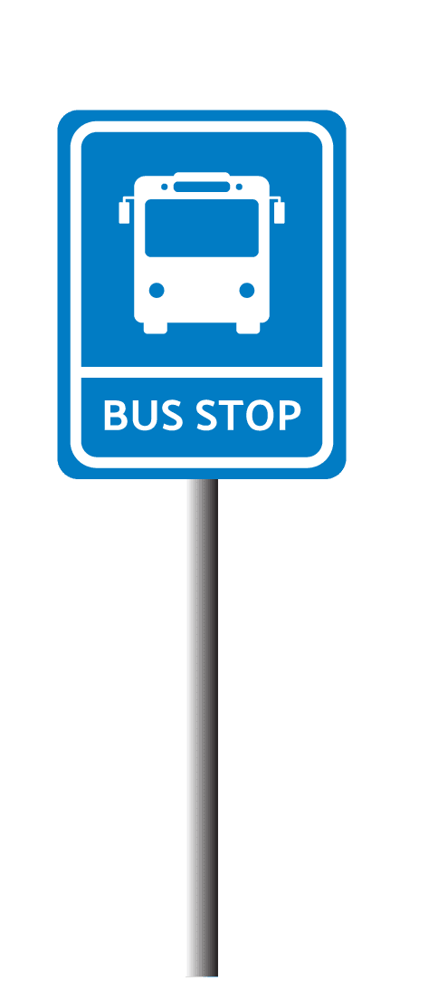
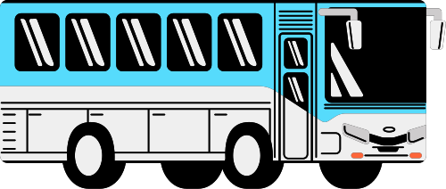
Bus Stops in Montgomery County
Grace Sampson
Notes:
Have you ever had to wait over 10 minutes at a bus stop with no bench? What if it was raining and there was no shelter? Or you had a snack wrapper but there was no trash can to discard it into? Lacking bus stop infrastructure can negatively affect all community members, even if only to the degree of fostering littering due to lack of trash cans. Not having benches or shelters can especially impact bus reliant commuters who cannot stand for long periods of time due to things like physical ailments, age, or pregnancy

Slide 2
Datasets
Bus Stops:
data Montgomery
Ride On and WMATA bus stops maintained by Montgomery County and municipalities
Total Benches, Shelters, and Trash Cans
Maryland Local Transit - Montgomery County Ride On Stops:
Maryland.gov
RideOn stops in Montgomery County
Stop Code, Town

Slide 3
Goals
Identify reasons why bus stops lack infrastructure in Montgomery County
Suggest paths for improvement

Slide 4

Tools + Cleaning
R Studio
Tidyverse
Stringr
Sf
Leaflet
Standardizing variable names
Removing commas from numeric entries
Creating new variable ‘Type’
Joining datasets
Notes:
My final joined dataset represents 5253 bus stops in Montgomery County across 23 variables. There are 26 towns which include cities like Rockville and Gaithersburg as well as census-designated places which notably include populous places like Silver Spring, Bethesda and Germantown.

Slide 5
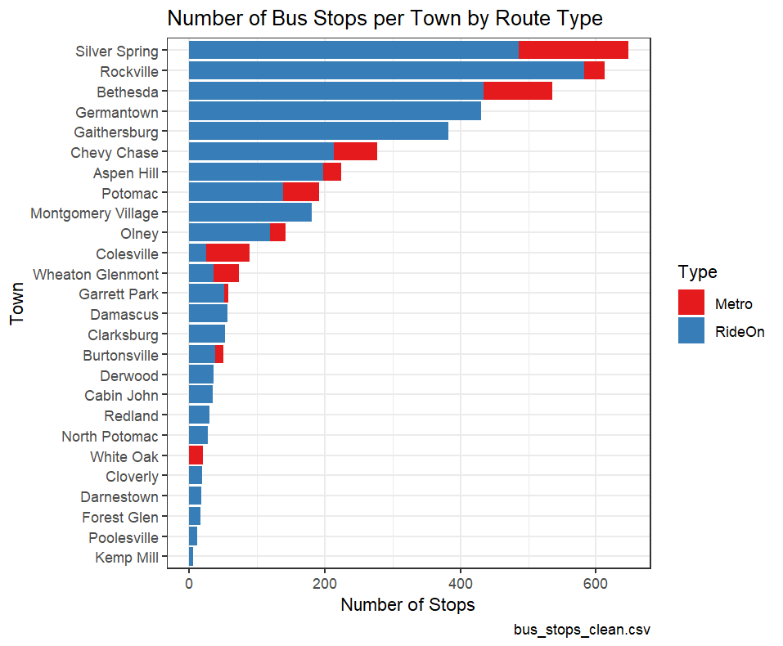
Lay of the Land
Silver Spring has the most bus stops overall, closely followed by Rockville and Bethesda.
Kemp Mill has the least bus stops.
The majority of bus stops only include RideOn routes.
White oak only has bus stops that include Metro routes.
Notes:
White Oak stands out as it only has stops that include Metro routes. This inconsistency becomes interesting when looking at the next bar chart which shows the proportion of bus stops with at least one bench for each town

Slide 6
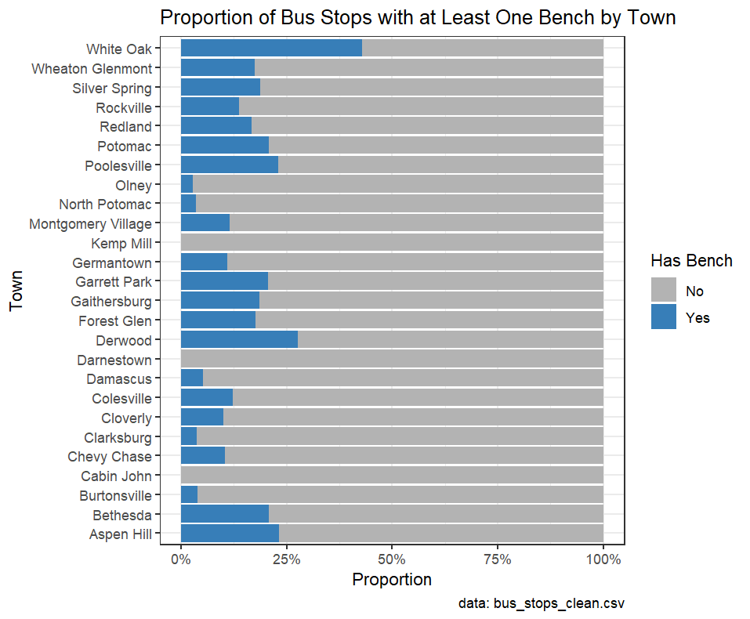
Bus stops with a bench
White Oak has the highest proportion of bus stops with at least one bench.
The majority of towns have a proportion less than 25%.
Notes:
This finding made me wonder if the type of routes that a bus stop services, that being RideOn or Metro, had a significant effect on the amount of infrastructure, or amenities, a stop had.

Slide 7
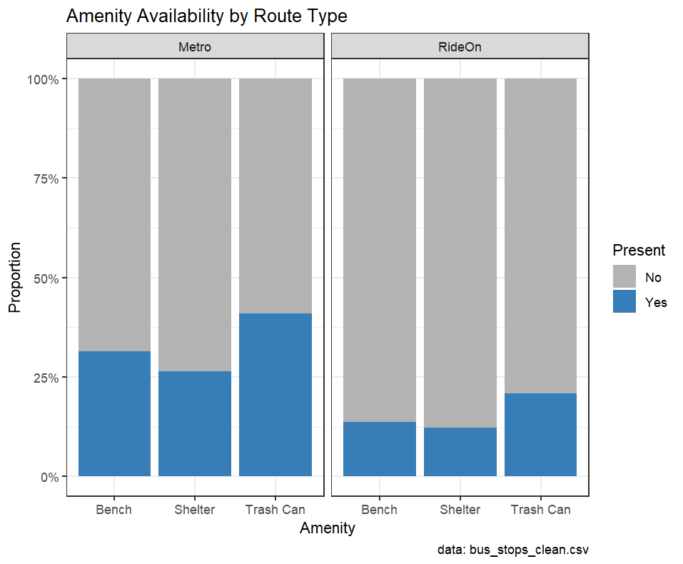
Metro vs. RideOn
Bus stops including Metro routes have higher percentages across all amenities.
Supports claim
Notes:
Supports the claim that there is an infrastructural difference between RideOn and Metro bus stops.

Slide 8
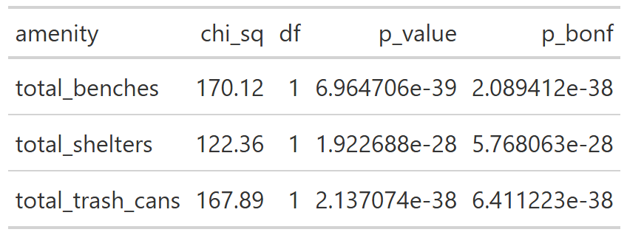
Statistical Significance
Notes:
This test resulted in all the amenities having significant p-values (< 0.05) even after Bonferroni correction. This means that the type of route that passes through a stop is strongly associated with whether a stop has amenities.
While the chi-squared test doesn’t tell us this directly, from the previous graph we know that this means that Metro bus stops generally have better infrastructure than RideOn bus stops.

Slide 9
Potential Reasons
Less Metro bus stops overall
Metro bus fare
Metro bus operating zone
Budget stress on MDOT
Notes:
As seen in graph 1…
Metro buses charge a fare while RideOn buses have been free to all riders under 18 since 2019 and completely fare-free since June 29, 2025.
Metro operates across the DMV while RideOn routes operate mainly within the county.
Maryland is currently facing a transportation budget shortfall of $2.1 billion, which can put stress on transit operating budgets (Goffman).

Slide 10
Potential Reasons
Focus on low bench rate towns like Olney and Clarksburg
Focus on towns with high elderly populations
Notes:
While not specifically represented in this project’s dataset, the town of Leisure World, located near Silver Spring, has a significant amount of active adult homeownership opportunities which cater to the needs of older adults (Montgomery Planning).

Slide 11
Reflection
Challenges:
Creating connected data story
Implementation in R Studio
Retrospective Changes:
Using population and demographic data directly in joined dataset
Rewards:
Completing the project
Finding statistical significant
Nearest Neighbors implementation

Slide 12
Next Steps
Expanded Nearest Neighbors analysis:
Include plotting where bus stops are located in specific towns
Logistic Linear Regression:
Include variables like population and age demographics
Notes:
I would be interested to focus more on the nearest neighbors analysis and plot where bus stops are located in specific towns with large and small distances between bus stops with benches. Doing this could potentially give insight into what factors influence bench placement and where benches could be placed to lessen the distance between bus stops with benches
While the previously mentioned chi-squared test showed that type was significant in determining infrastructure, we don’t know the size of that influence which a regression would express.

Slide 13
Acknowledgements
Professor Alraee
Professor Perine
Professor Park
Data Montgomery
Data 205 classmates
Early College data science cohort

Slide 14
Sources
Goffman, Ethan. “Transit advocates weigh in on Maryland’s $2B transportation shortfall.” Greater Greater Washington, Greater Greater Washington, 16 Janurary 2024, https://ggwash.org/view/92186/with-maryland-facing-2-billion-in-transportation-cuts-advocates-say-transit-needs-to-be-prioritized. Accessed May 2026.
Montgomery Planning Research and Strategic Projects Division. “Older Adult Population in Montgomery County.” Montgomery Planning, Montgomery Planning, 2024, https://montgomeryplanning.org/wp-content/uploads/2025/05/Older-Adult-Population-Profile-FINAL.pdf. Accessed May 2026.

